Slide 1
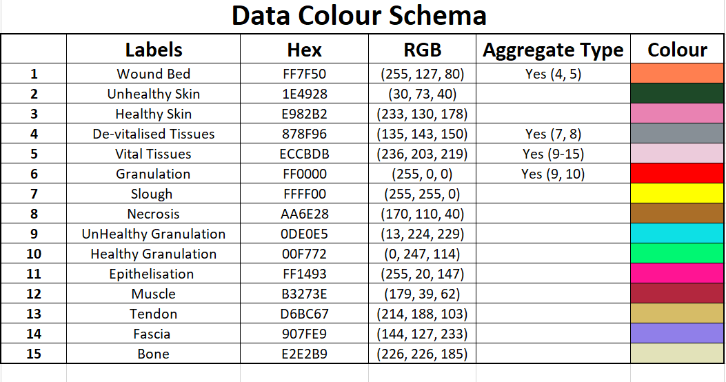

Slide 2
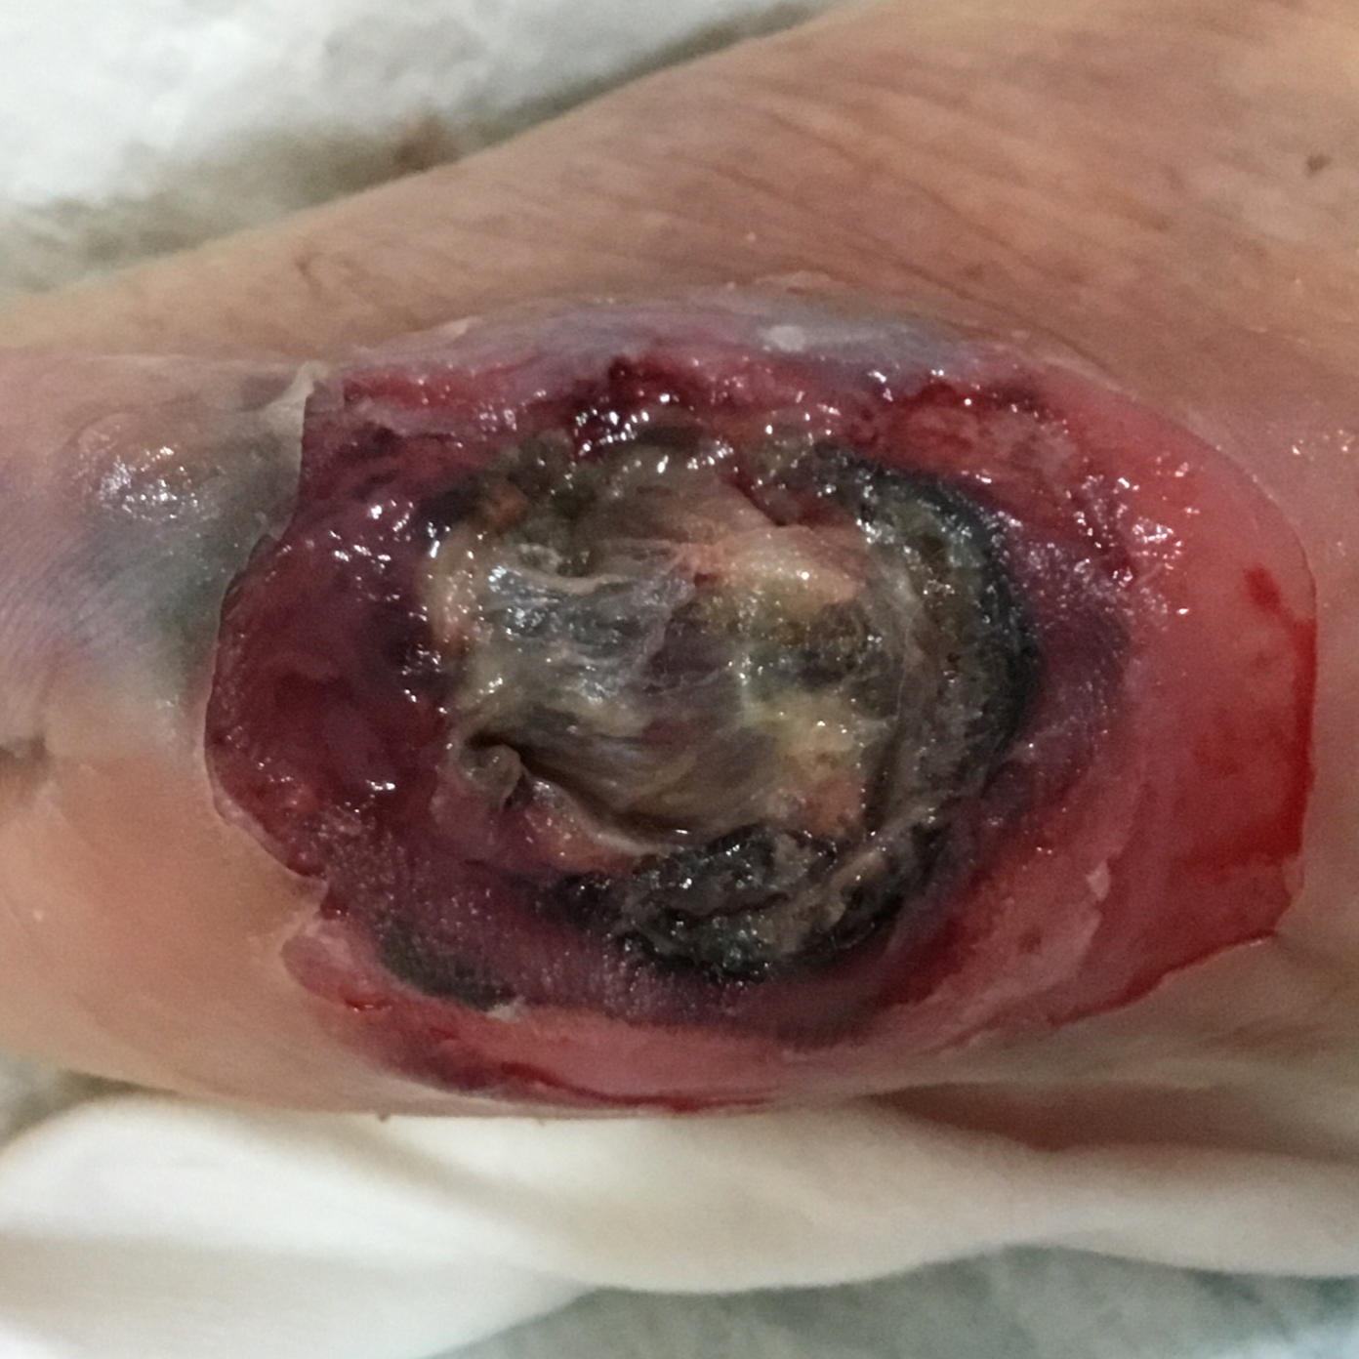
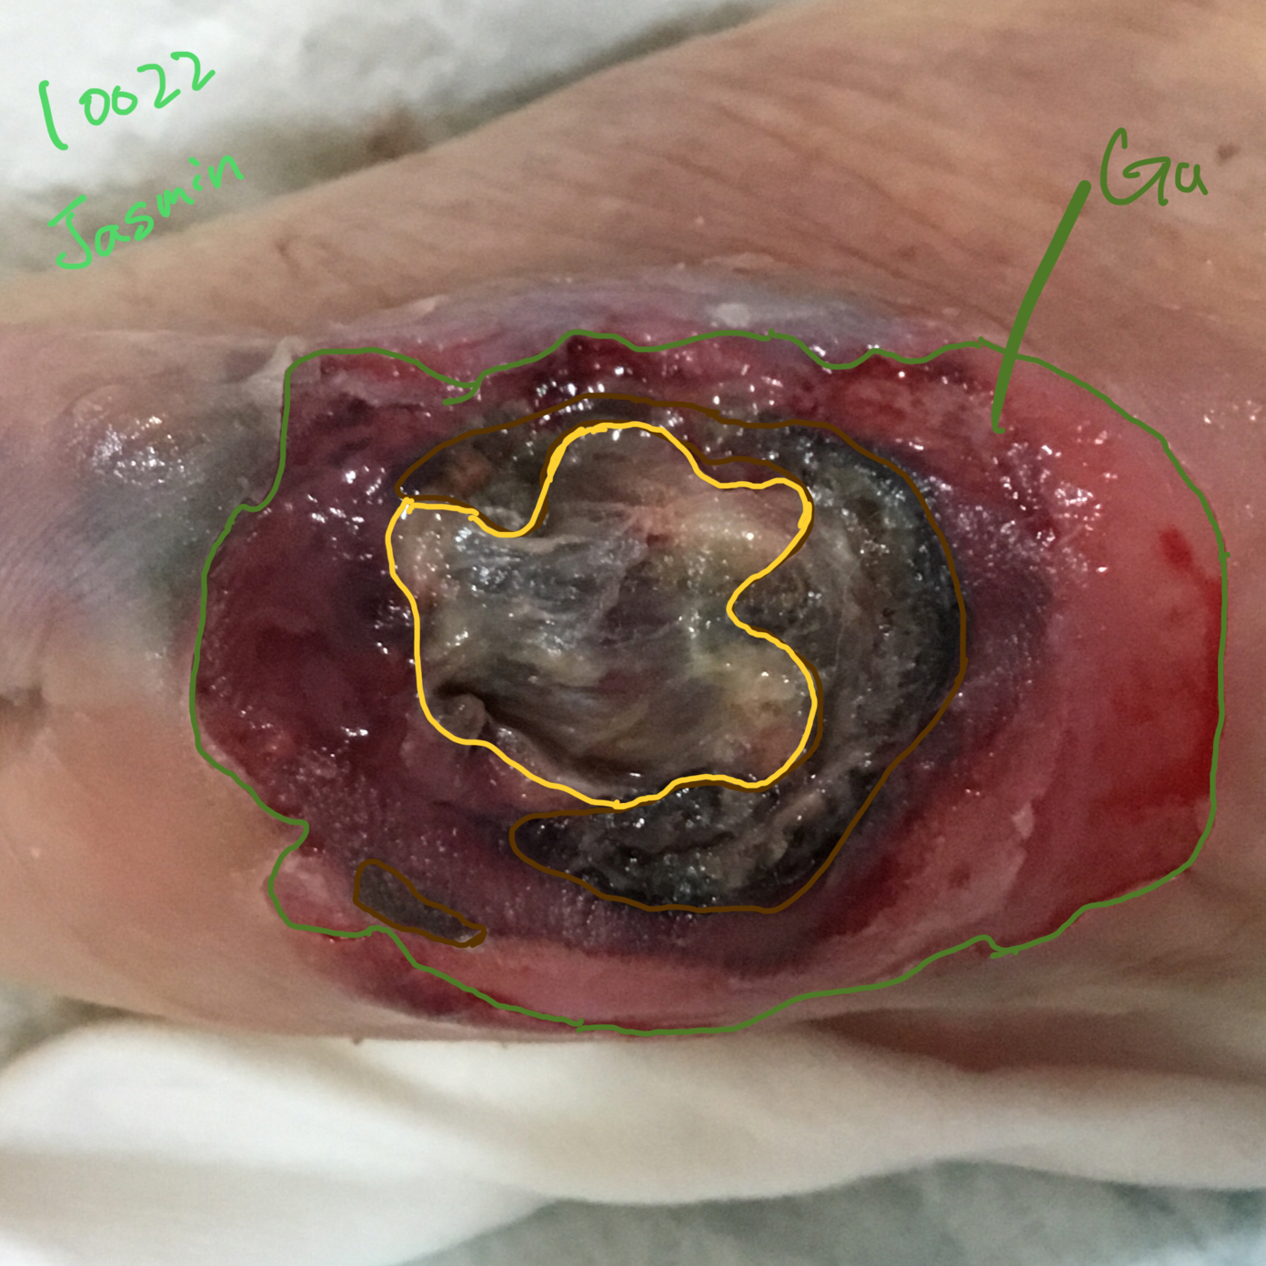
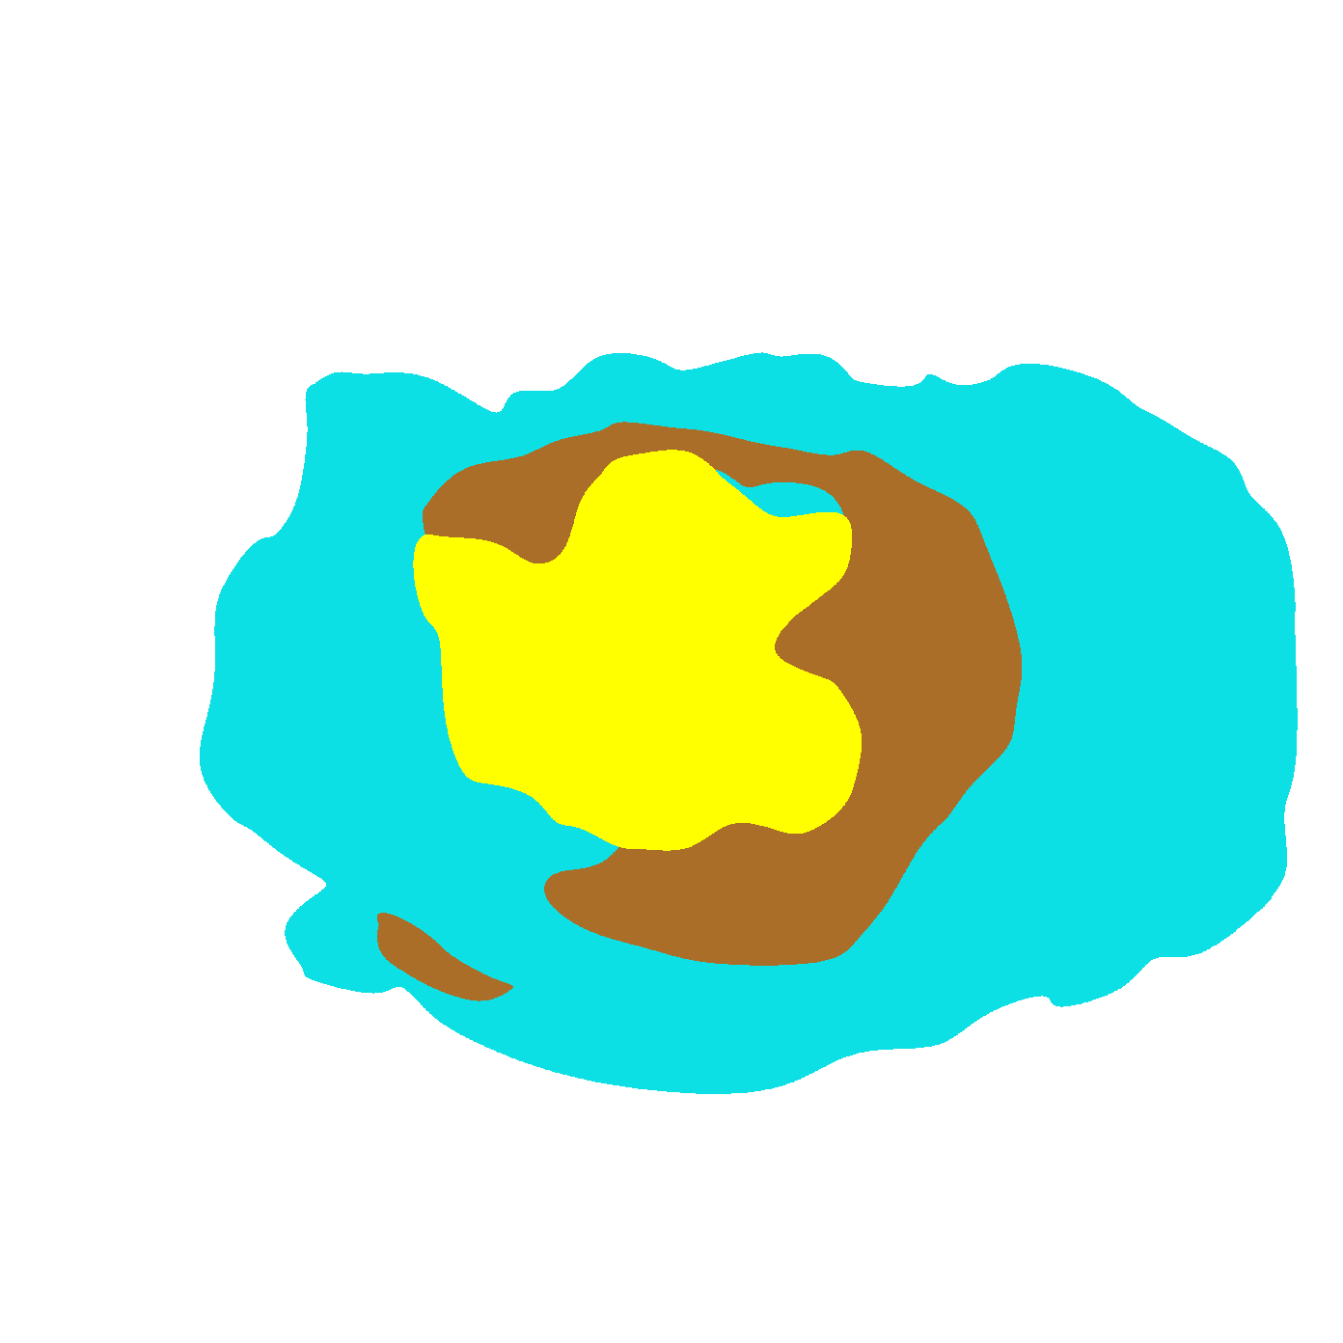
Original Wound Img
Latest Annotation
Original Mask
Metadata Wound Location: Foot Wound Type:

Slide 3
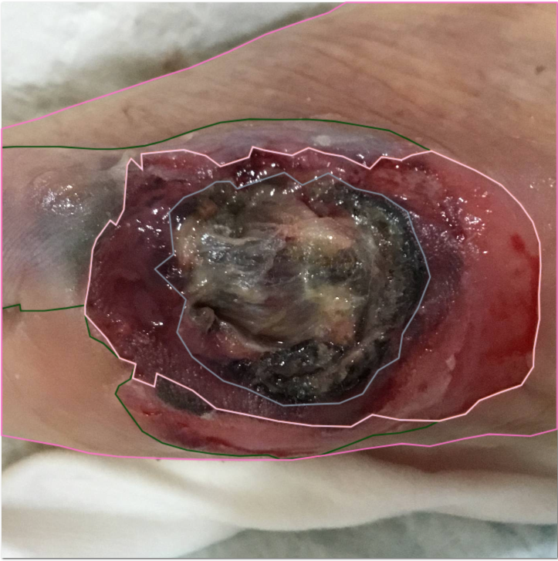
not sure if this area is considered granulation
it is actually healthy granulation
not sure if this area is considered unhealthy skin
Epithelization
Notes:
See my black annotation to see the borders of that recategorization
Remember this is an inside out wound. The difference between the granulation and epithelization is minimal and more to do with the moisture level and texture.

Slide 4
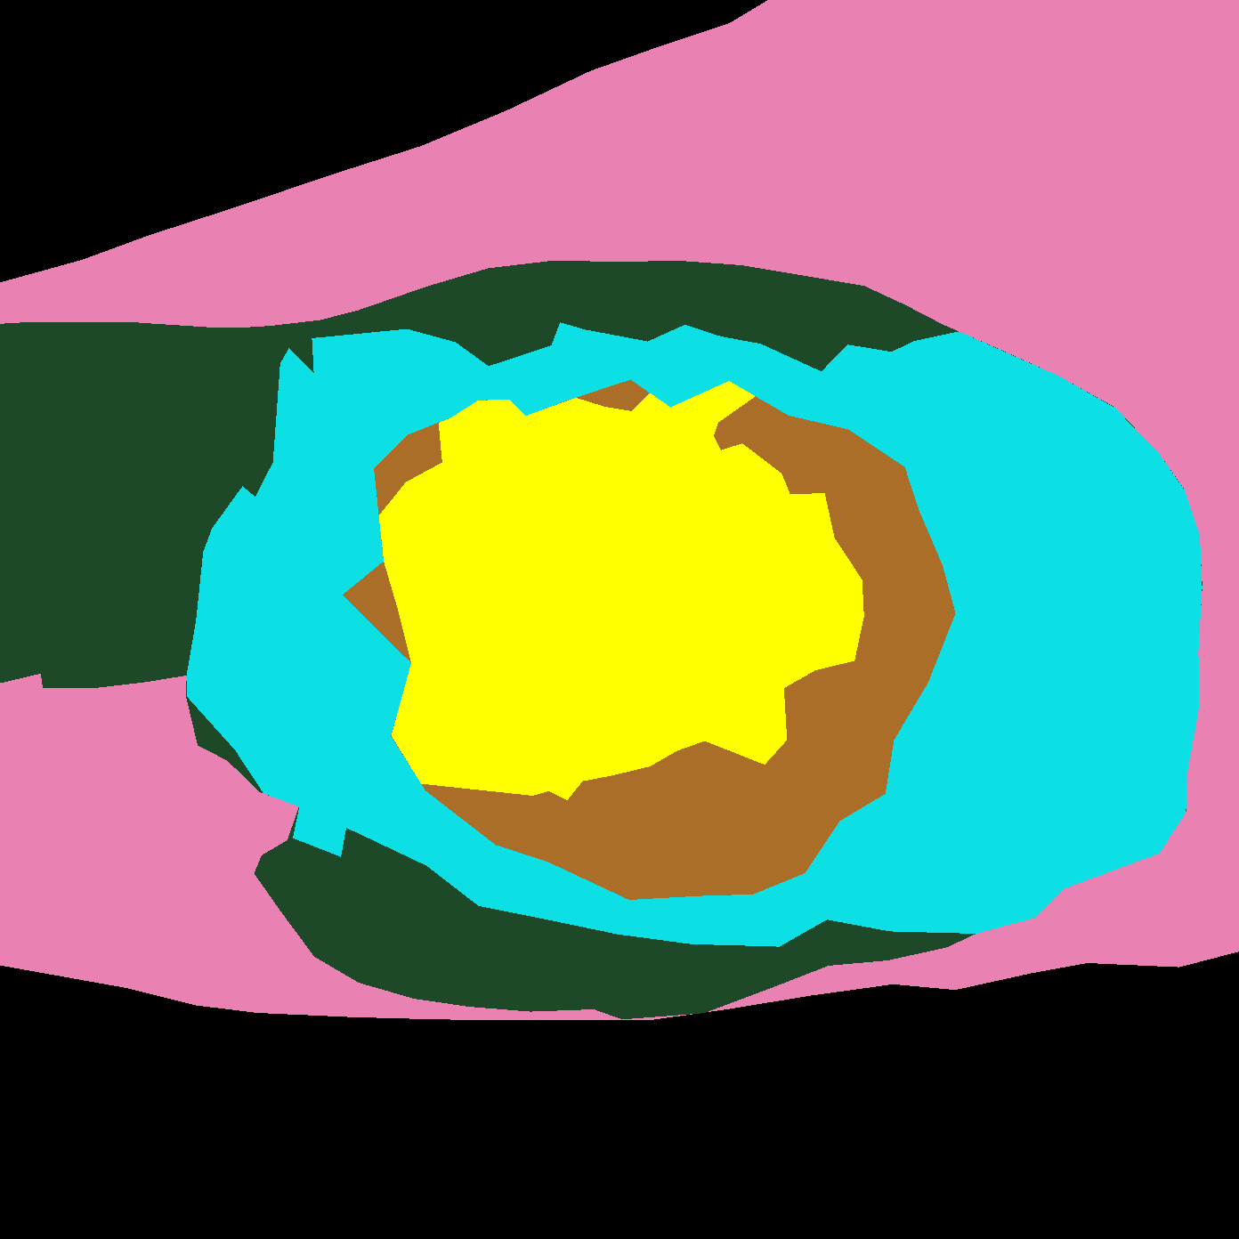
Original Wound Img
New Mask
Original Mask
Notes:
You are missing healthy

Slide 5
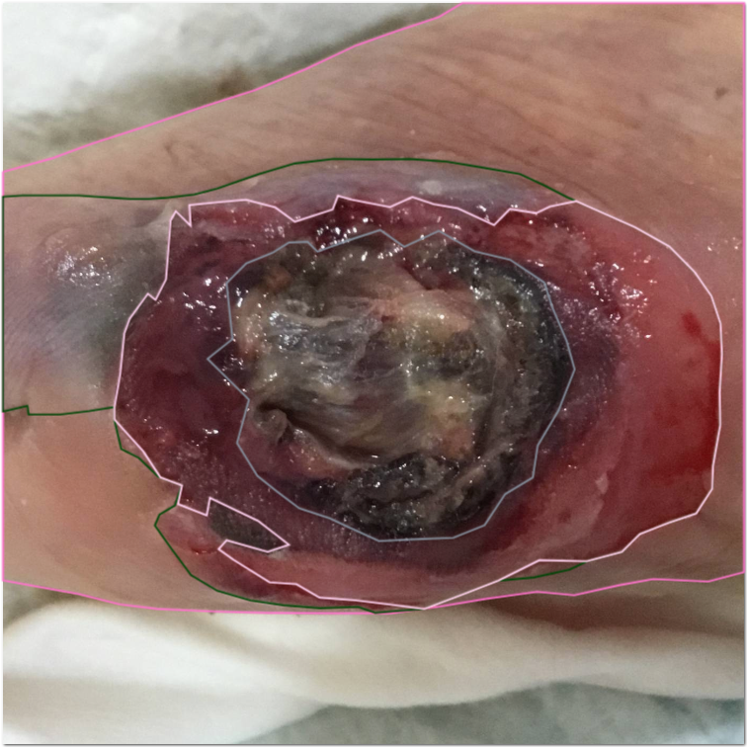

Slide 6
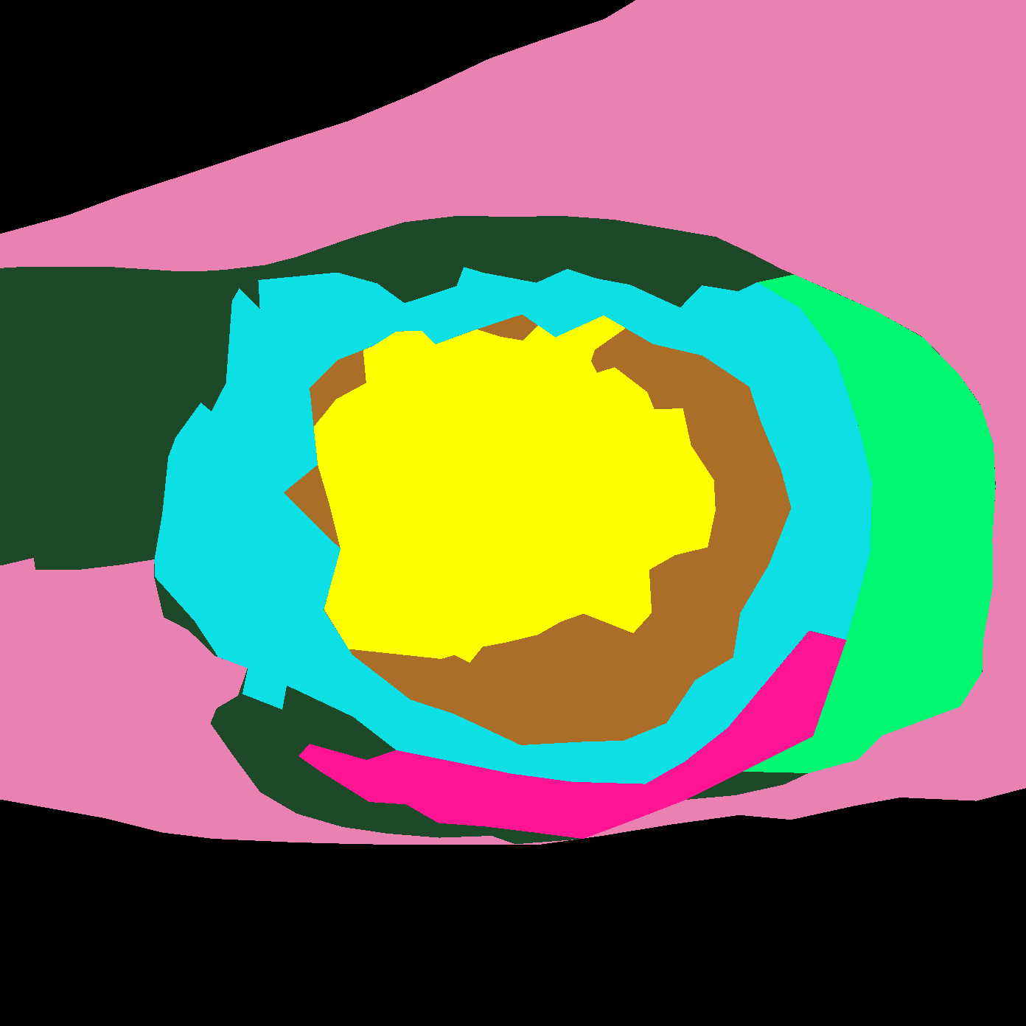
SD: Make the edges curvy to be like the wound
JX: Accepted

Slide 7


Slide 8
